Slide 1
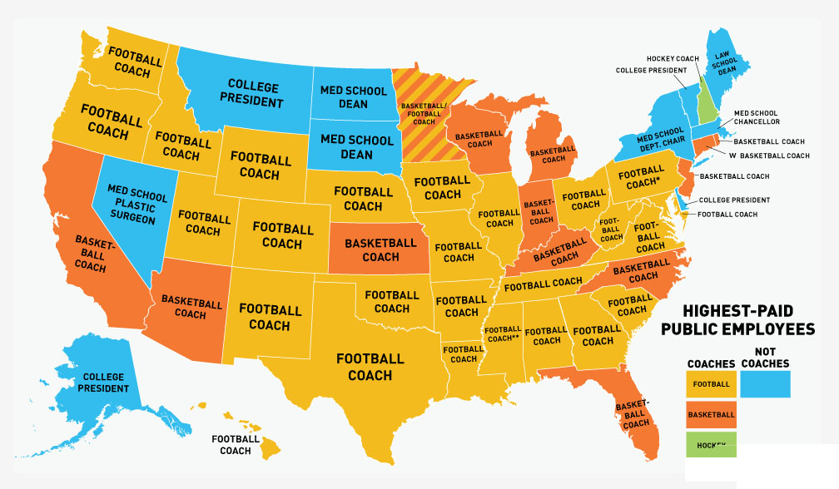

Slide 2
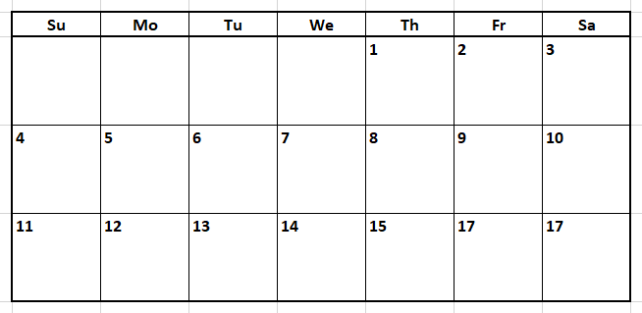
Plan
Review &
Euclidian
Distance
Geoprocessing
Cost Distance
Site Suitability
Review Exam

Slide 3
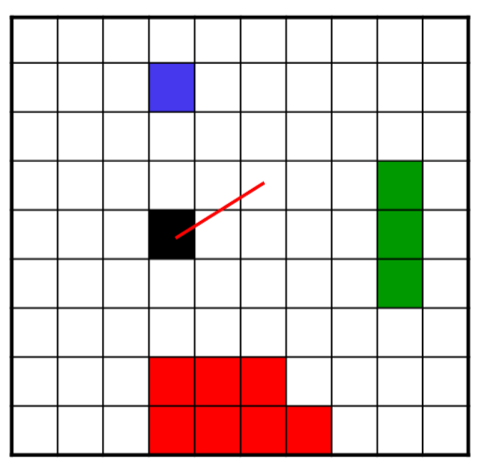
Distance Operations in Raster Data Model
Characterize the relationships between each cell and some feature cells (source cells) in space
Nearest feature cell
Distance to nearest feature cell
Direction to nearest feature cell

Slide 4
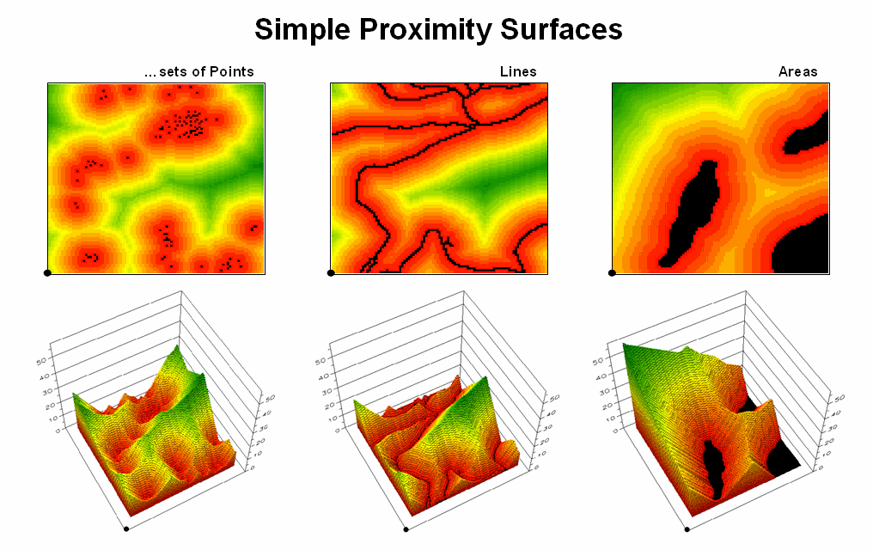
Notes:
http://www.innovativegis.com/basis/mapanalysis/topic25/Topic25_files/image007.png

Slide 5
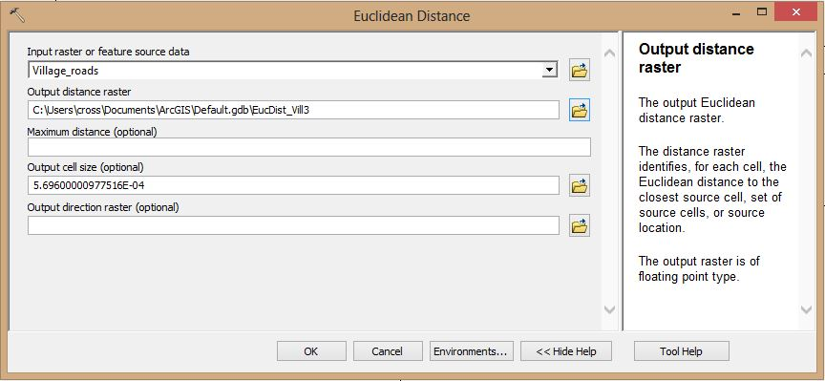
Euclidean Distance
EucDistance(in ArcGIS) operation calculates the shortest distance from each cell to source cells.
Pythagorean theorem: distance between the center of a cell and the center of a source cell.

Slide 6
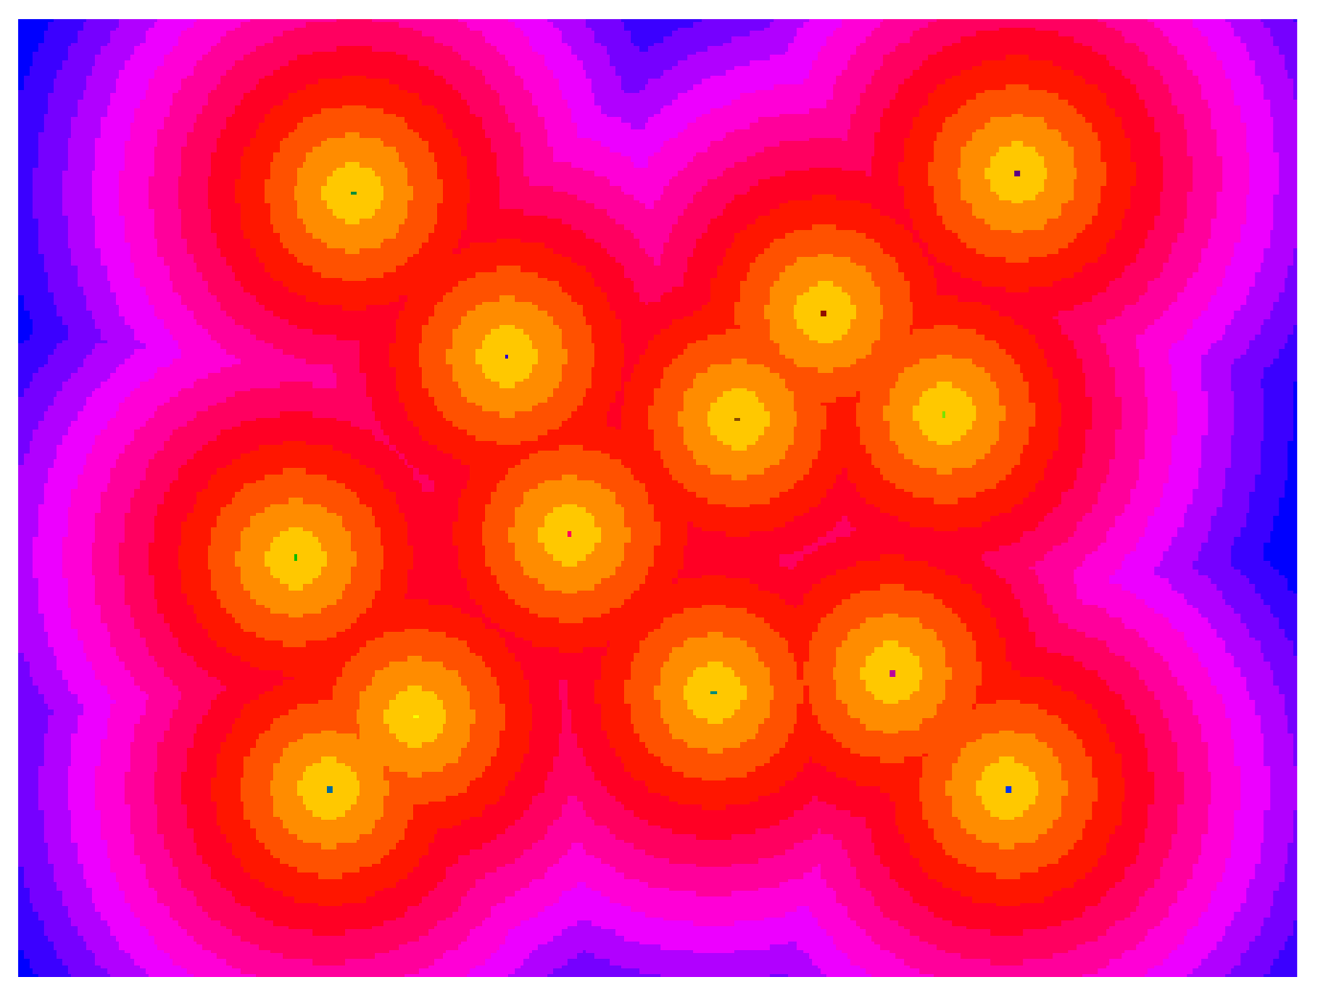

Slide 7
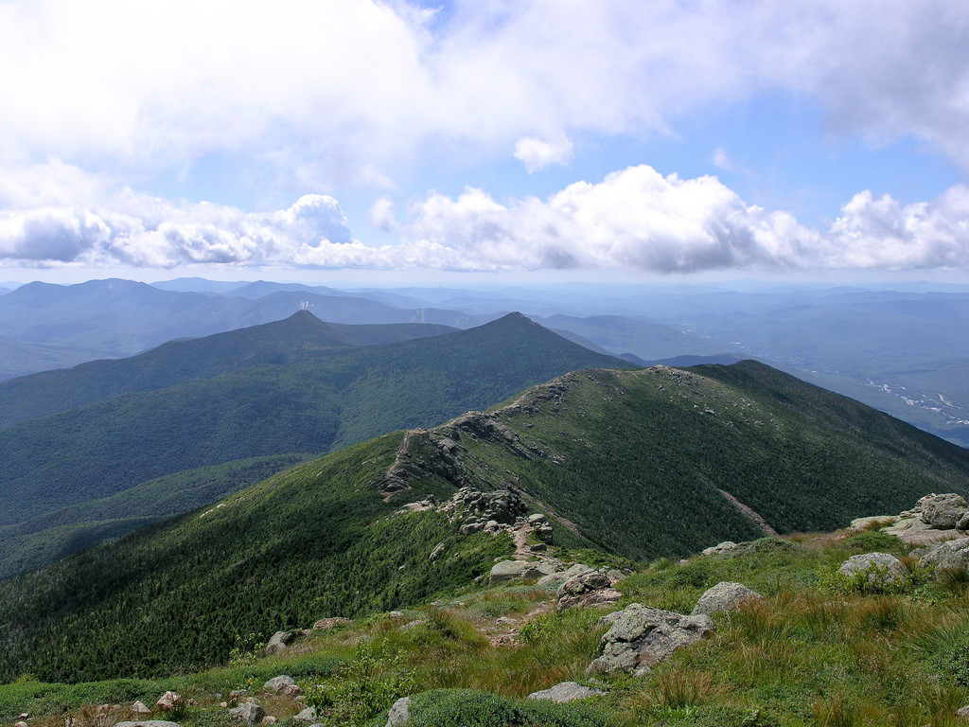

Slide 8
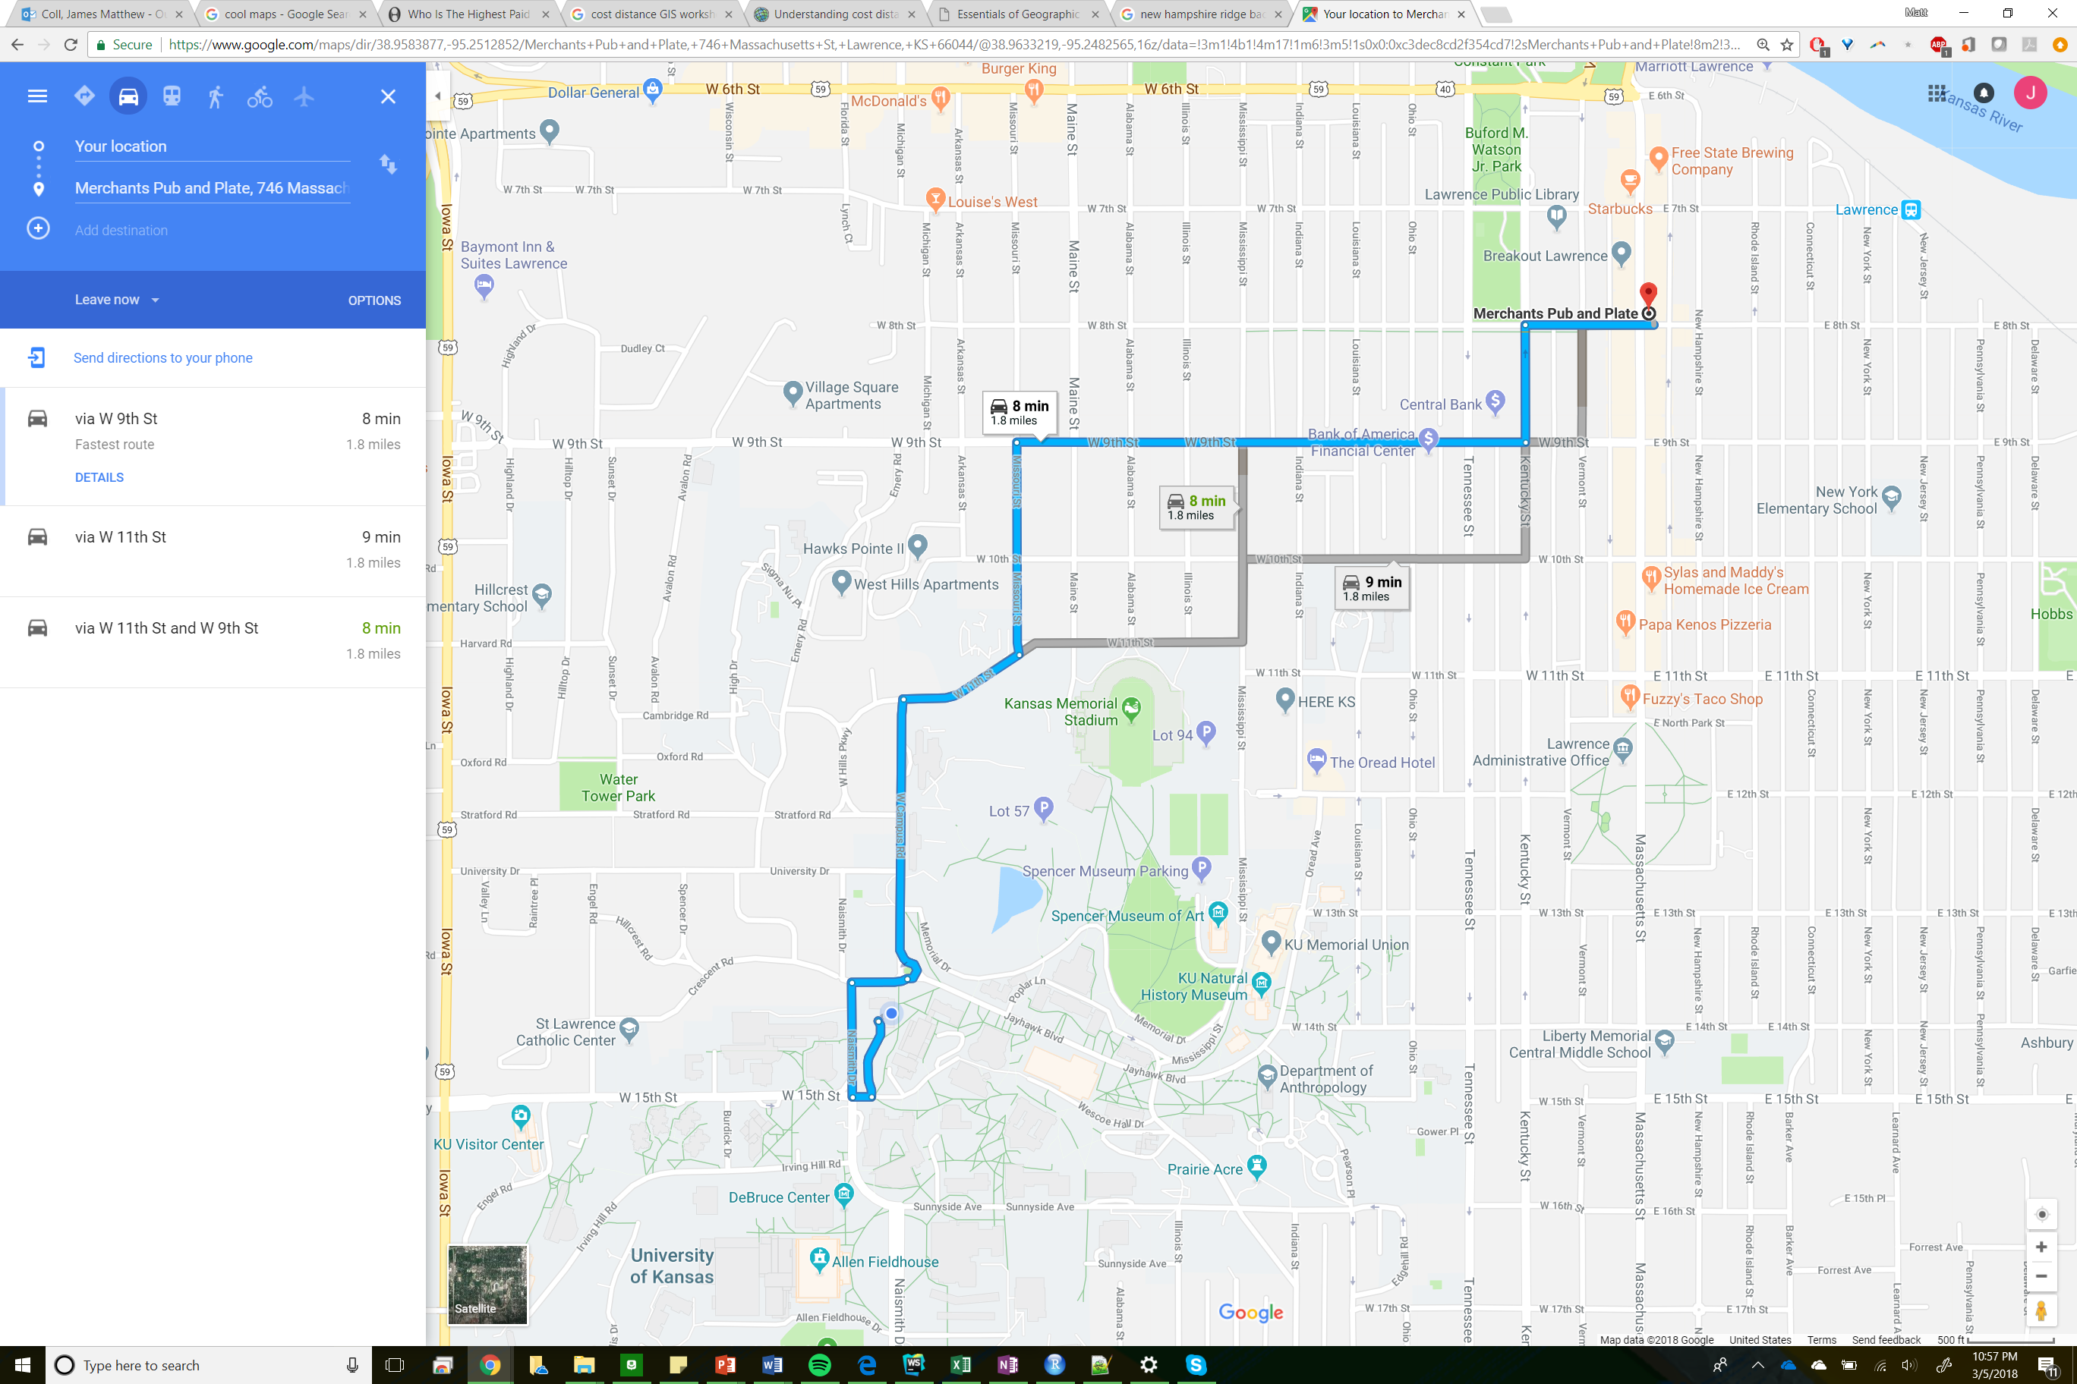

Slide 9
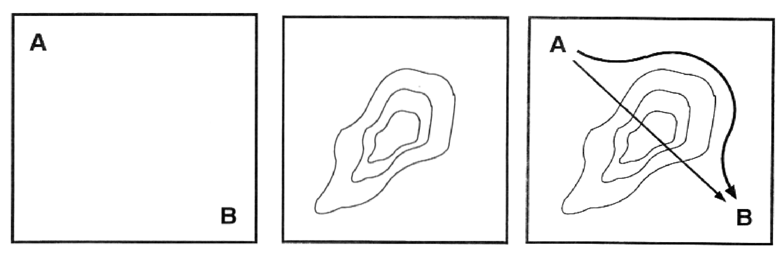
Non-Euclidean Distance
Distance (between A and B) is one type of cost
Can be measured as time or money spent
That cost (friction) may vary in space and time
Least cost and least cost path
CostDistance functions in ArcGIS

Slide 10
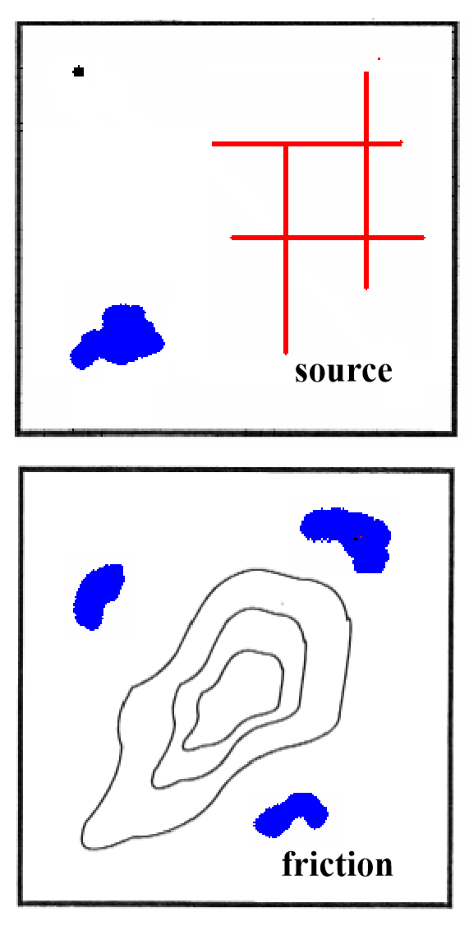
CostDistance Operations
Compute he least cost from each cell to the source cells
Source raster
Points/Lines/Polygons
Non-sources set to NODATA
Friction Raster
Cost encountered by traveling through that cell
Distance / time / dollars / effort
Units of cost per unit distance
Barriers can be created with NODATA

Slide 11
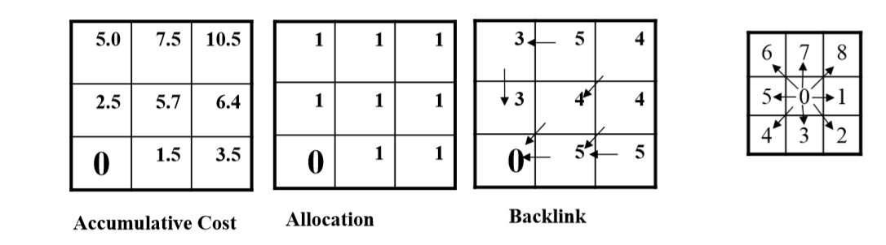
CostDistance Outputs
Accumulated Cost
Least cost from each cell to a source cell
Cell Allocation
Identifies the source cell of that cell (proximal regions)
Path Back
Direction code to the nearest source cell

Slide 12
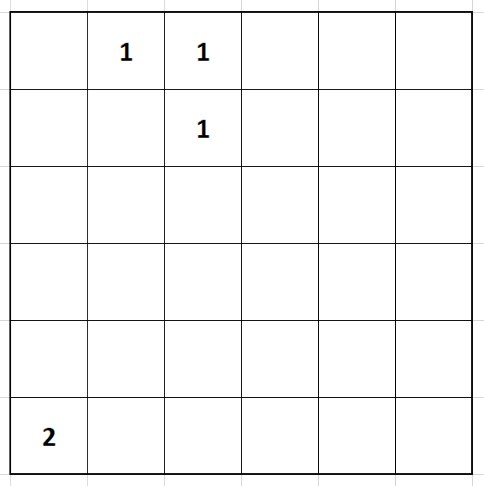

Slide 13
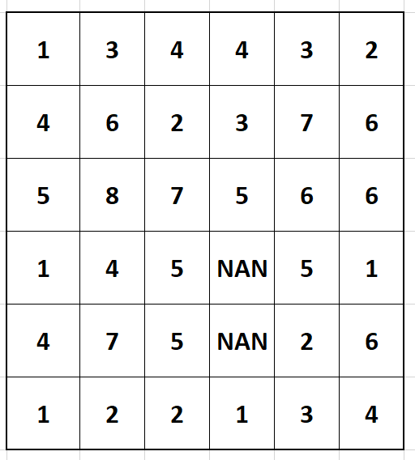

Slide 15
Fric 1
Fric 2
Cost = (Fric1+Fric2)/2

Slide 16
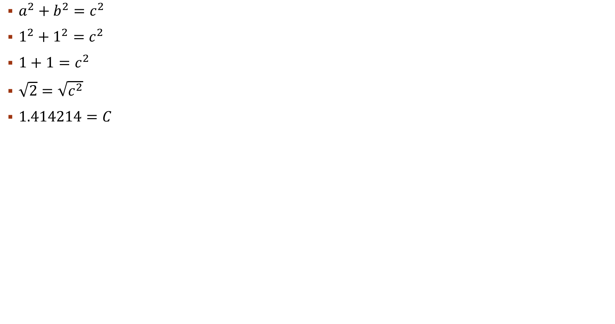
$a^{2}+b^{2}=c^{2}$
$1^{2}+1^{2}=c^{2}$
$1+1=c^{2}$
$\sqrt{2}=\sqrt{c^{2}}$
$1.414214=C$
A
B
C

Slide 17
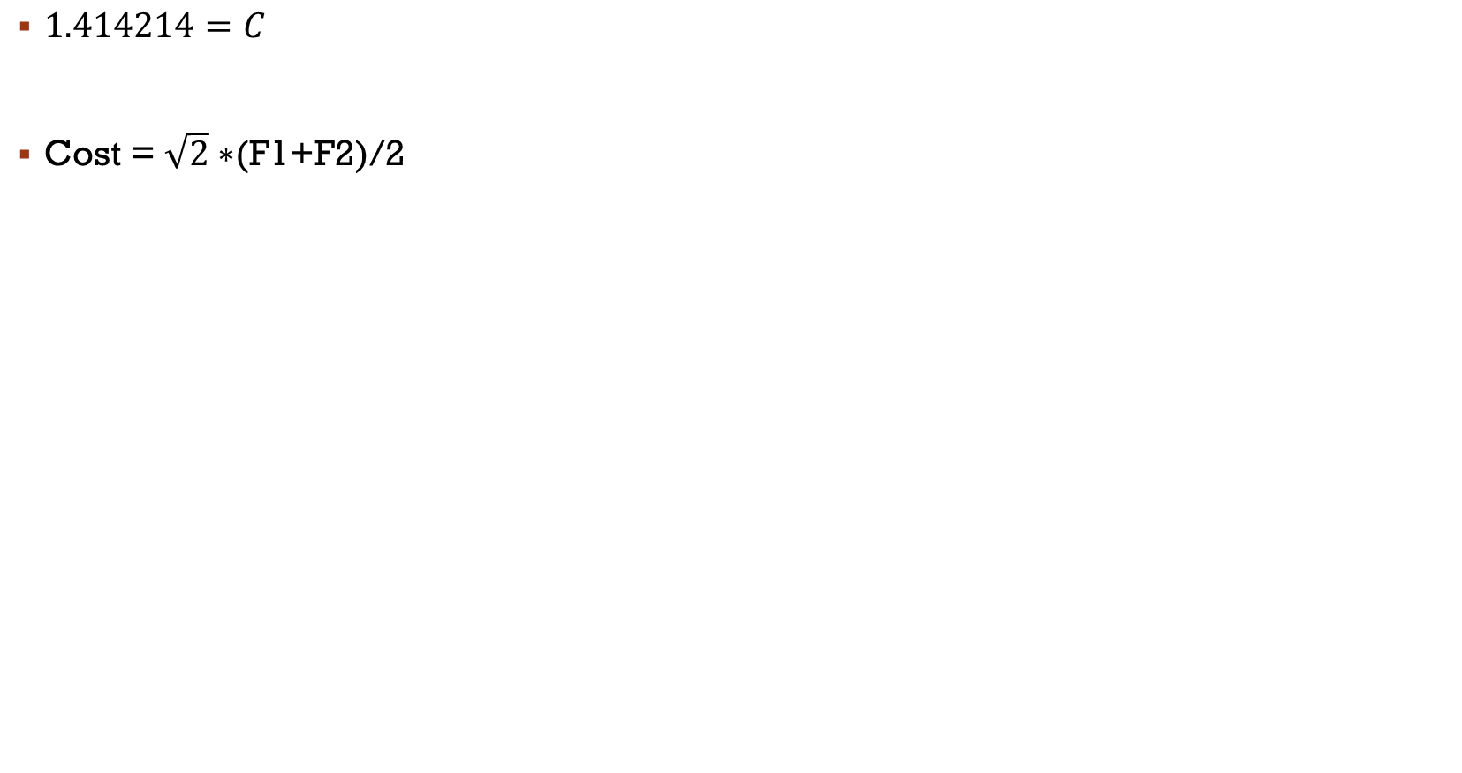
$1.414214=C$
Cost = $\sqrt{2}∗$(F1+F2)/2
F1
F2

Slide 18
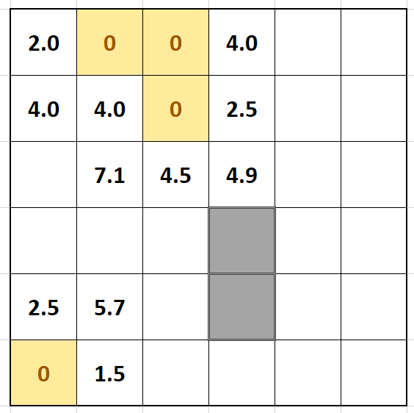
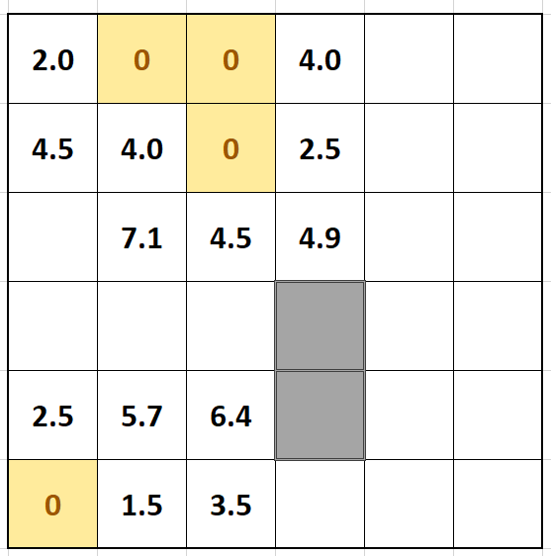

Slide 19
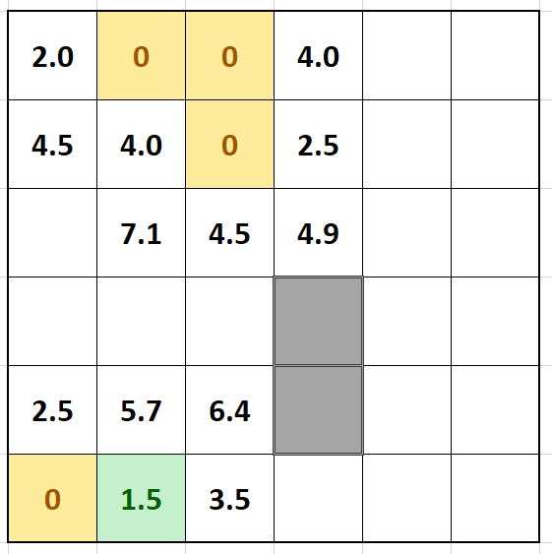

Slide 20
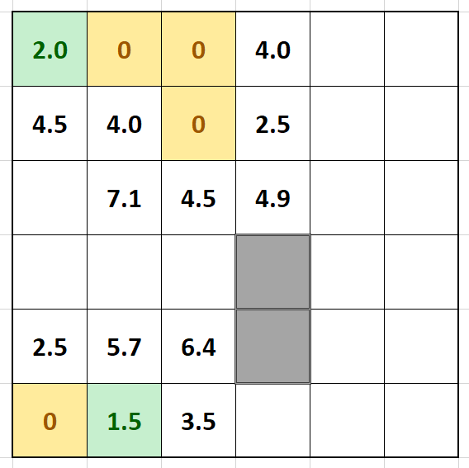

Slide 21
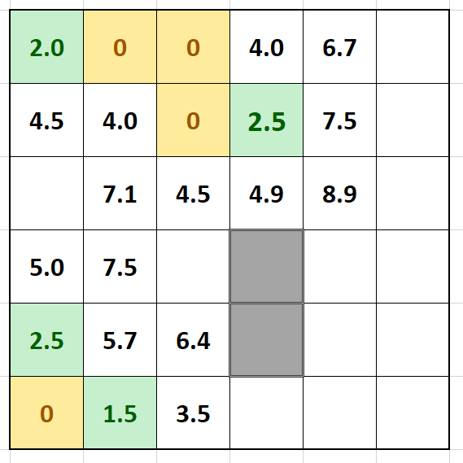

Slide 22
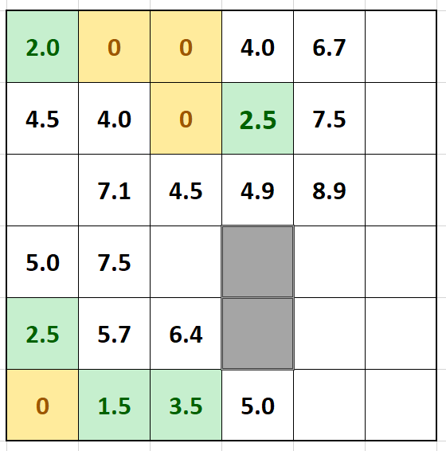

Slide 24
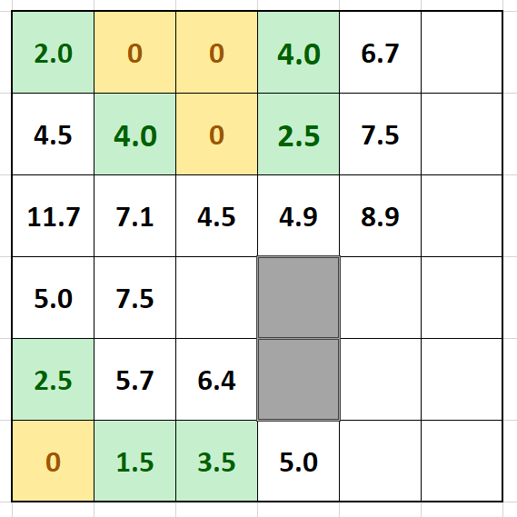

Slide 26
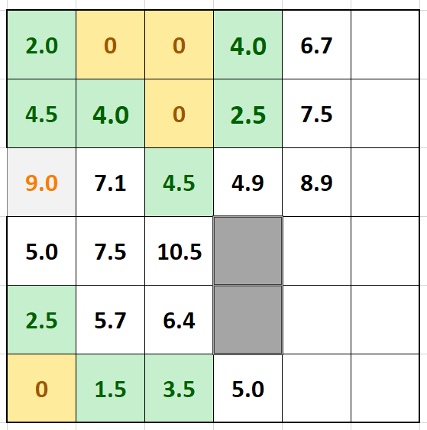

Slide 27
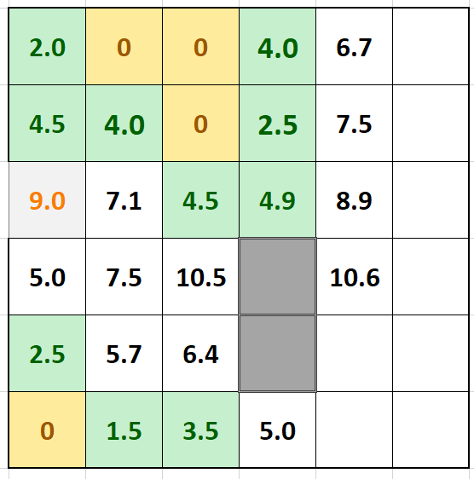

Slide 28
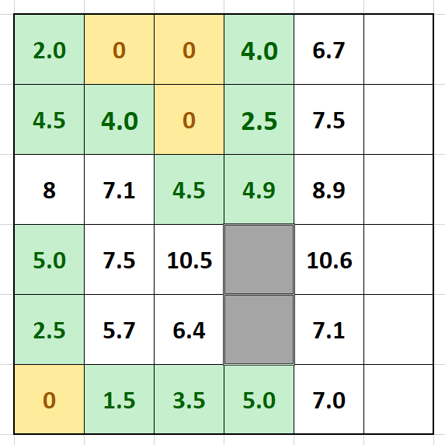

Slide 29
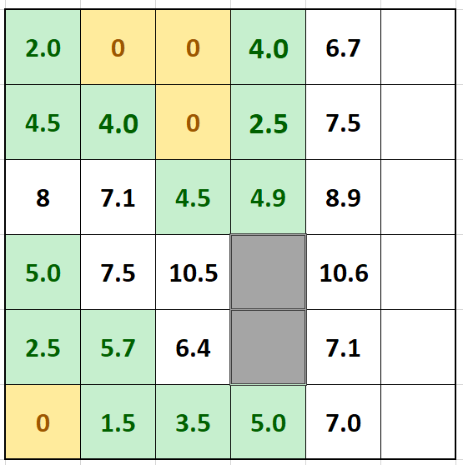

Slide 30
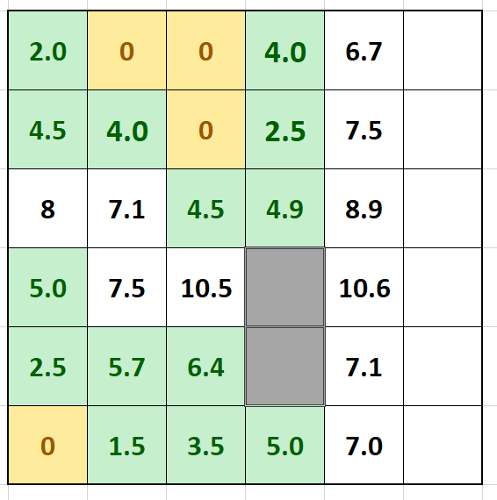

Slide 31
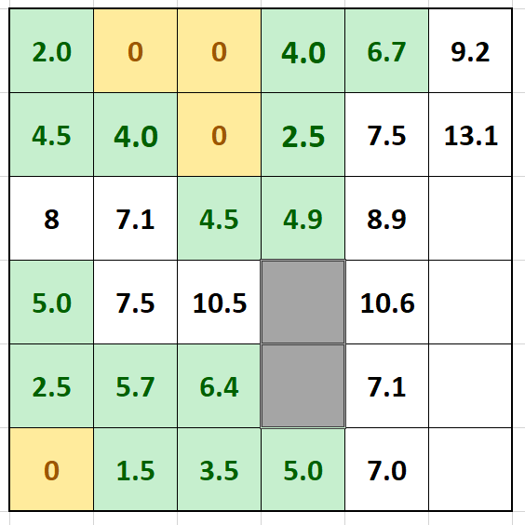

Slide 32
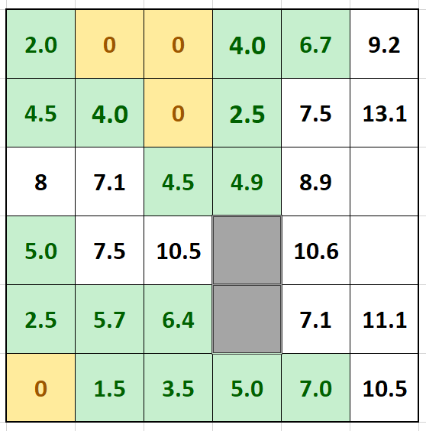

Slide 33
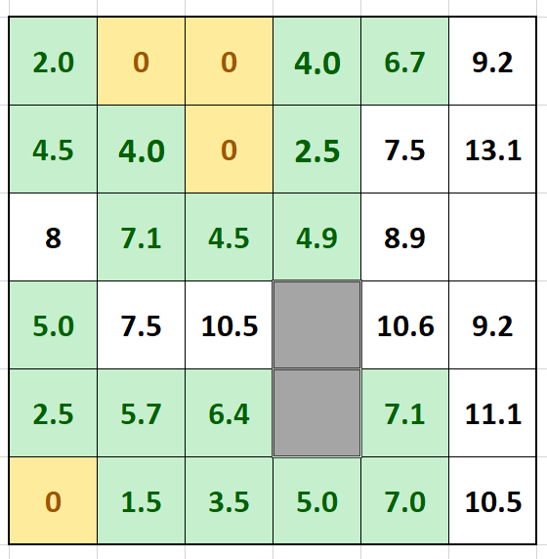

Slide 34
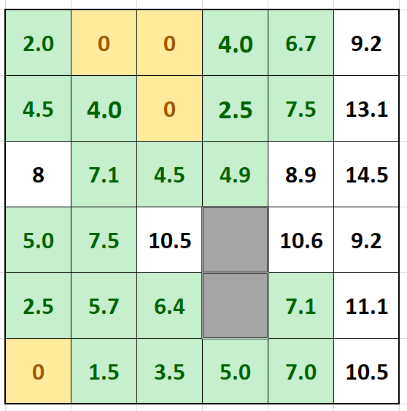

Slide 35
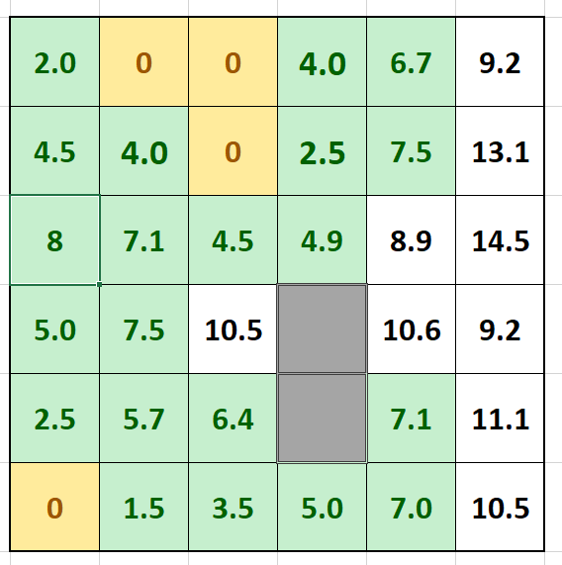

Slide 36
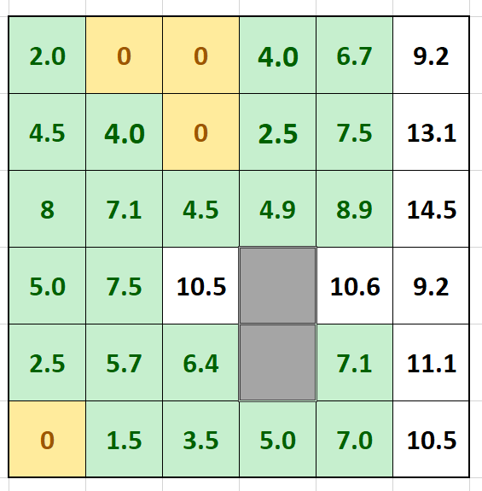

Slide 37
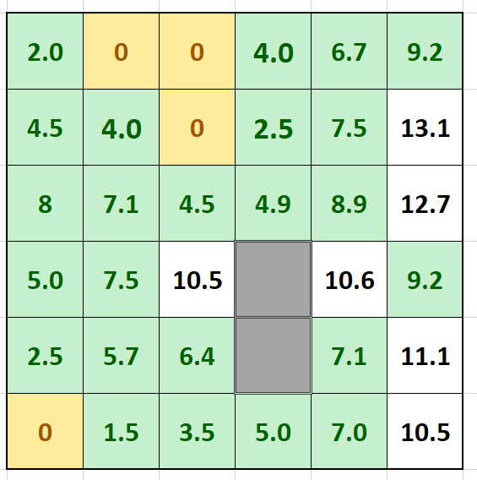

Slide 38
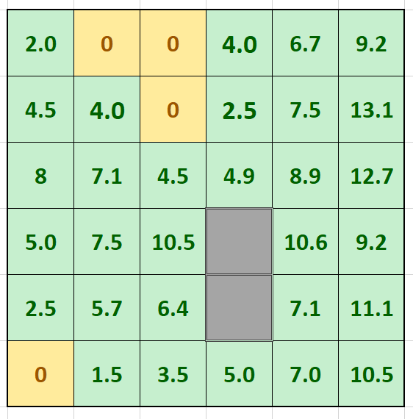

Slide 39


Slide 40
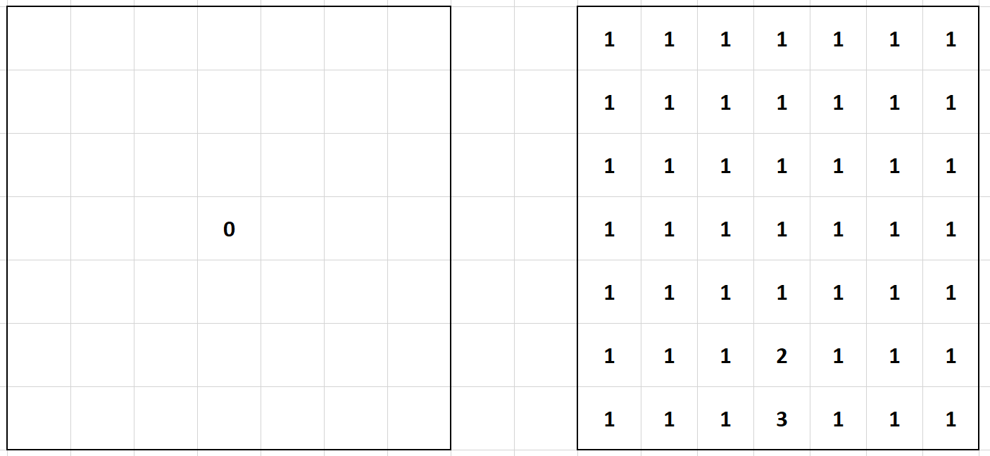

Slide 41
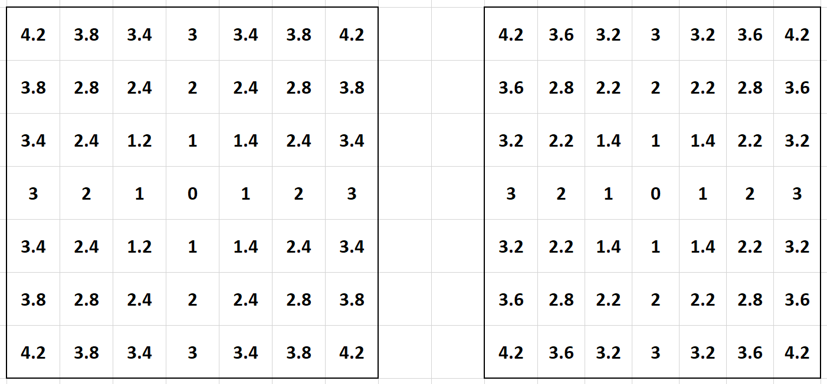

Slide 42
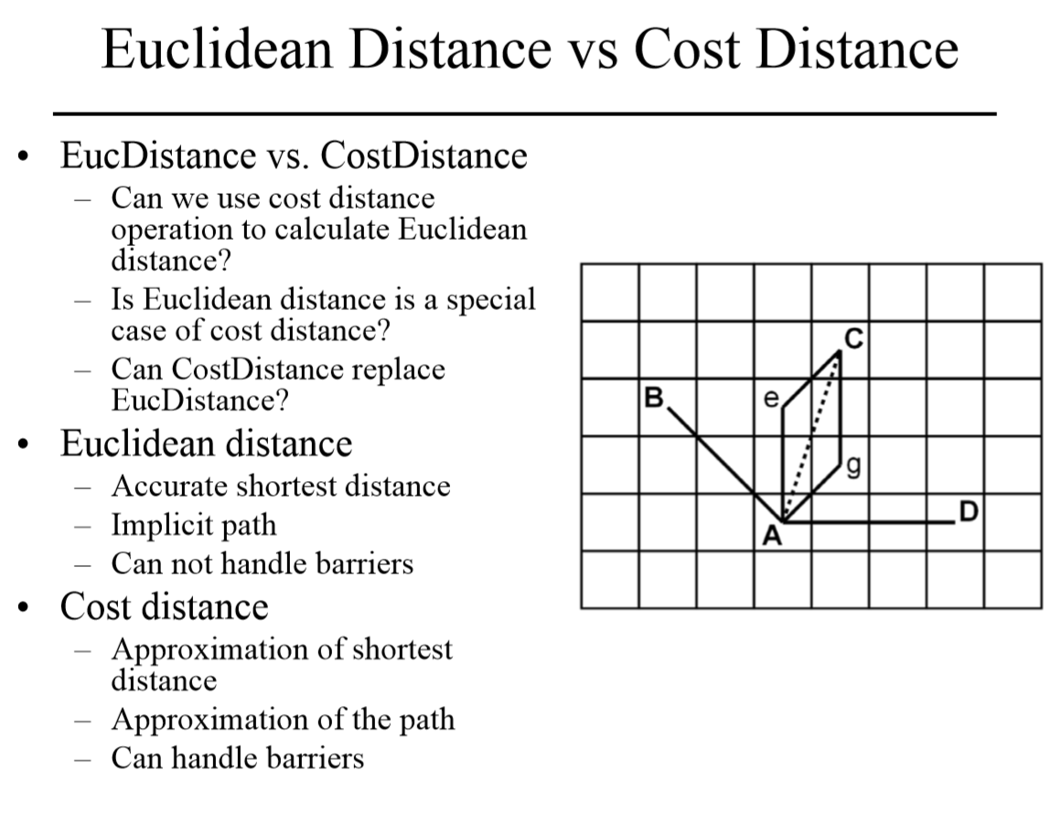

Slide 43
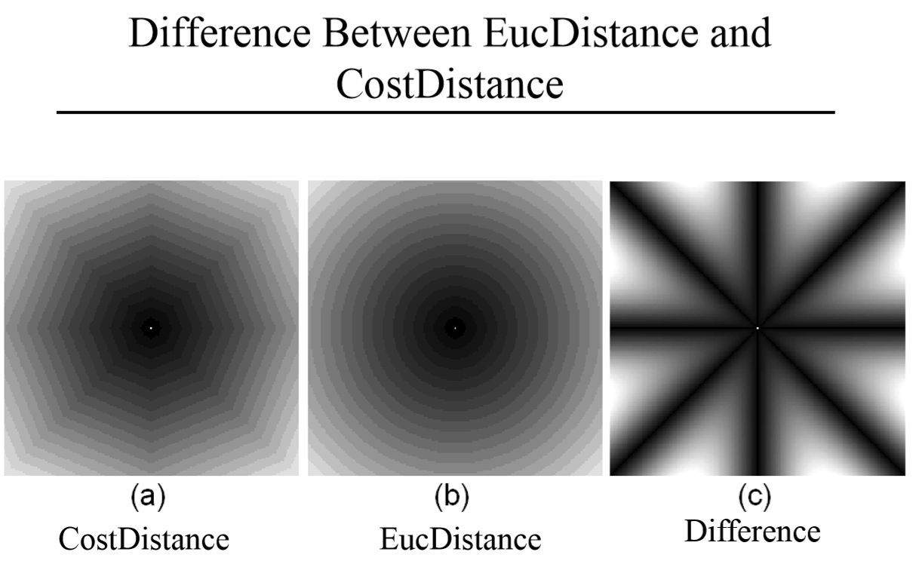

Slide 44
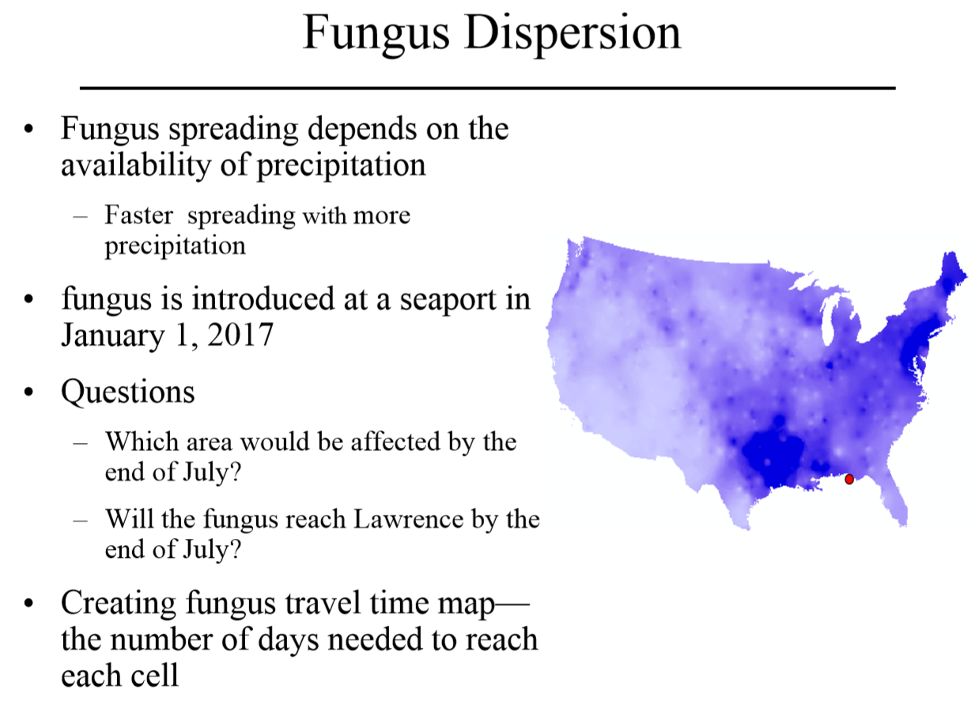

Slide 45
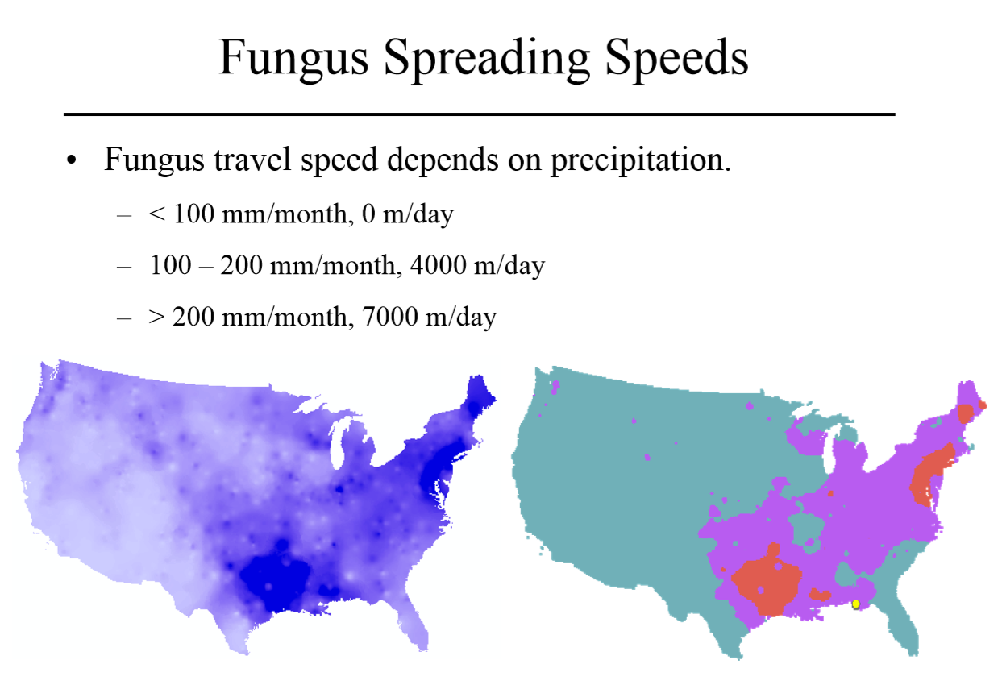

Slide 46
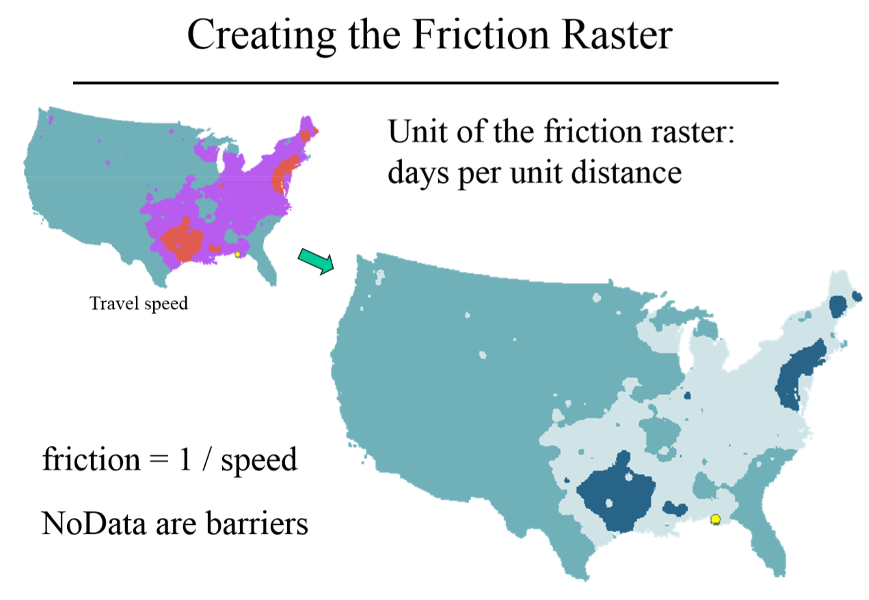

Slide 47
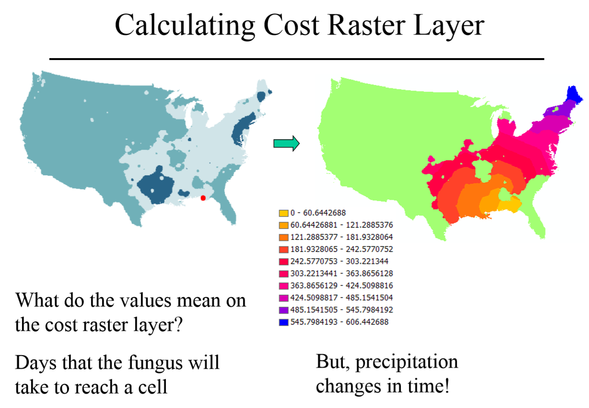

Slide 48
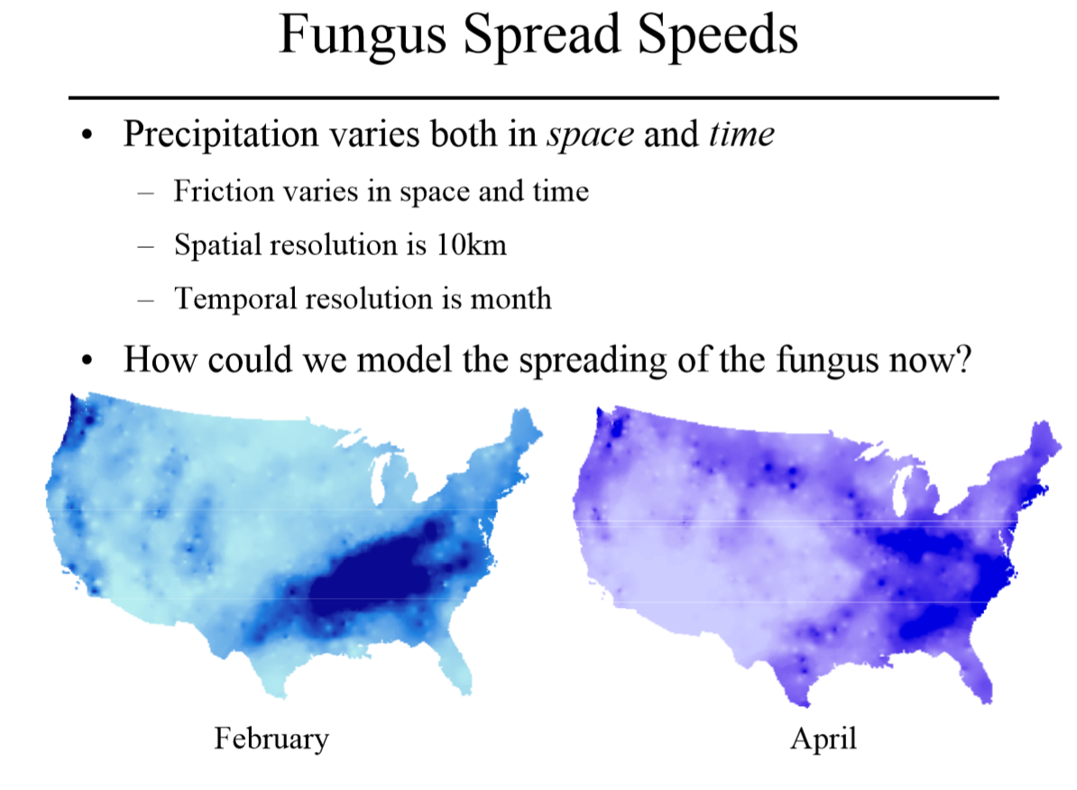

Slide 49
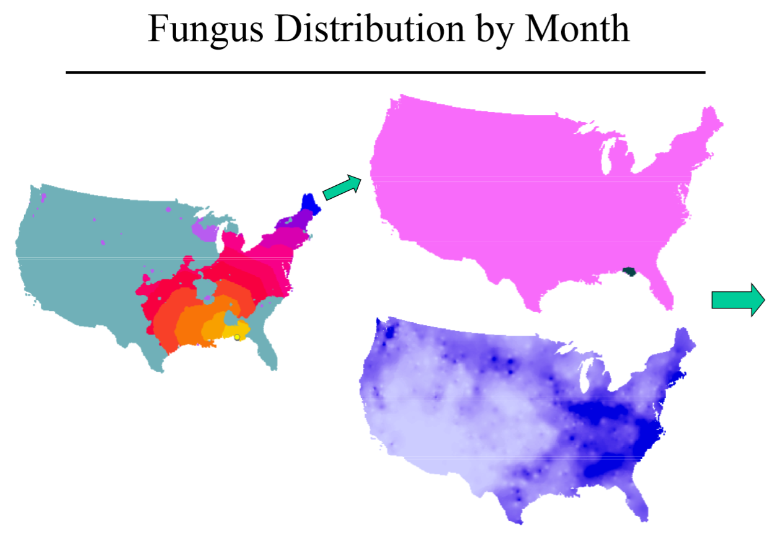

Slide 50
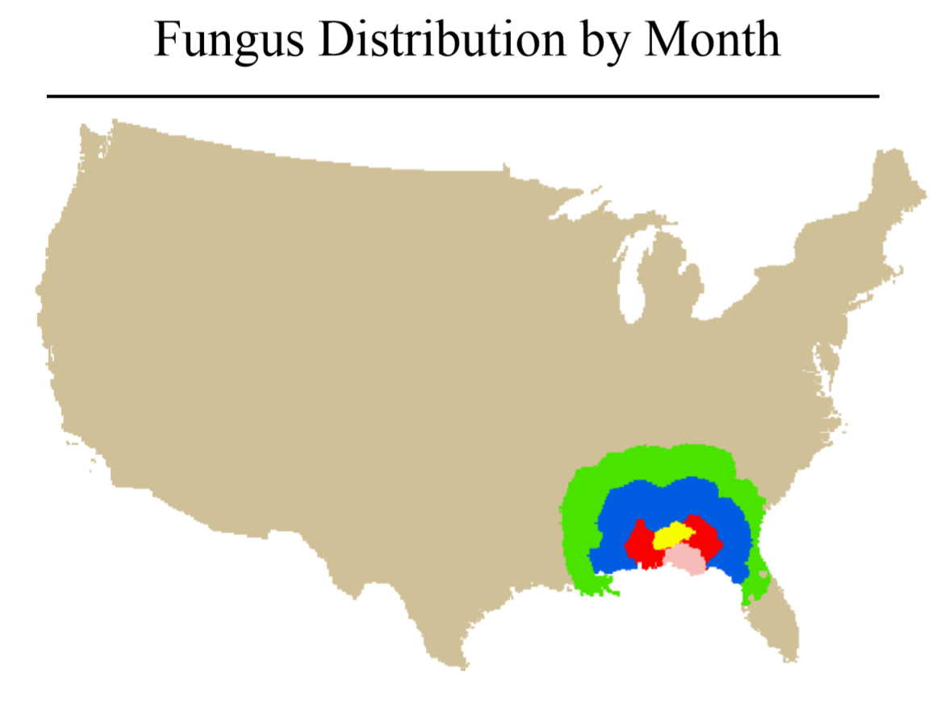

Slide 52
